Slide 1
Lesson 4 Overview
In the previous unit, you learned that the Command Staff supports the Incident Commander who is responsible for overall management of the incident.
This unit introduces you to the General Staff.
By the end of this unit, you should be able to:
Identify the Incident Command System (ICS) titles used for General Staff members.
Describe the major activities of the four general staff sections.

Slide 2
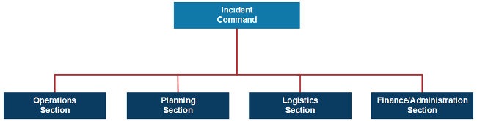
General Staff
To maintain span of control, the Incident Commander may establish any or all of the following four sections: Operations, Planning, Logistics, and Finance/Administration.

Slide 3
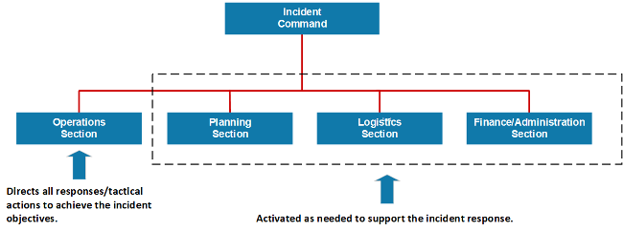
General Staff Overview
In an expanding incident, the Incident Commander first establishes the Operations Section. The remaining sections are established as needed to support the operation.

Slide 4

General Staff Overview Video

Slide 5
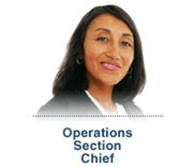
Operations Section
The Incident Commander determines whether there is a need for an Operations Section and, if so, will designate an Operations Section Chief.
It is up to the Operations Section Chief to activate any additional staffing that is needed. When the Operations Section Chief is designated, the staging and management of operational resources moves from the Incident Command to Operations.
If no Operations Section is established, the Incident Commander will perform all operations functions.

Slide 6
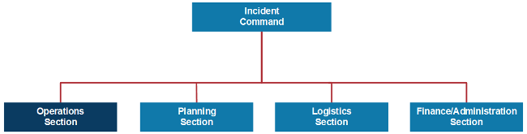
Operations Section Major Activities
The major activities of the Operations Section may include:
Implementing strategies and developing tactics to carry out the incident objectives
Directing the management of all tactical activities on behalf of the Incident Commander
Supporting the development of the Incident Action Plan to ensure it accurately reflects current operations
Organizing, assigning, and supervising the tactical response resources

Slide 7

Planning Section
The Planning Section Chief is designated only after the Incident Commander determines whether there is a need for a Planning Section.
It is up to the Planning Section Chief to activate any additional staffing that is needed.
The Incident Commander will perform all planning functions if no Planning Section is established.

Slide 8
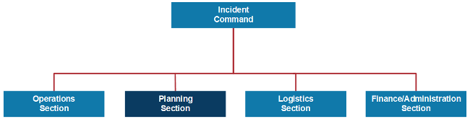
Planning Section: Major Activities
The major activities of the Planning Section may include:
Preparing and documenting Incident Action Plans
Managing information and maintaining situational awareness for the incident
Tracking resources assigned to the incident
Maintaining incident documentation
Developing plans for demobilization

Slide 9
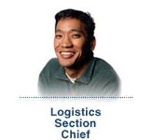
Logistics Section
The Logistics Section Chief is designated only after the Incident Commander determines whether there is a need for a Logistics Section.
It is up to the Logistics Section Chief to activate any additional staffing that is needed.
The Incident Commander will perform all logistics functions if no Logistics Section is established.

Slide 10
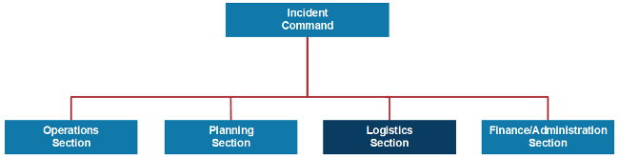
Logistics Section: Major Activities
The Logistics Section is responsible for all services and support needs, including:
Ordering, obtaining, maintaining, and accounting for essential personnel, equipment, and supplies
Providing communication planning and resources
Setting up food services for responders
Setting up and maintaining incident facilities
Providing support transportation
Providing medical services to incident personnel

Slide 11

Finance/Administration Section
The Incident Commander determines whether there is a need for a Finance/Administration Section at the incident.
If so, the Incident Commander will designate an individual to fill the position of the Finance/Administration Section Chief.
The Time, Compensation/Claims, Cost, and Procurement Units may be established within this section.

Slide 12
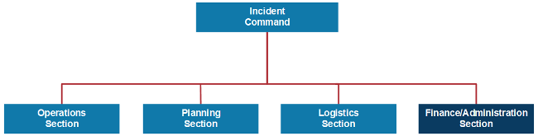
Finance/Administration Section: Major Activities
The Finance/Administration Section is set up for any incident that requires incident-specific financial management. The Finance/Administration Section is responsible for:
Contract negotiation and monitoring
Timekeeping
Cost analysis
Compensation for injury or damage to property
Documentation for reimbursement (e.g., under mutual aid agreements and assistance agreements)

Slide 13
Section Chiefs Activity 4.1
Activity Purpose: To review the General Staff Section responsibilities.
Instructions: Working individually:
Review the table in your Student Manual.
Identify the correct Section Chief for each statement.
Be prepared to share your answers in 5 minutes.
Time: 10 minutes

Slide 14

General Staff Review (1 of 5)
Which member of the General Staff is described below?
"In advance of severe flooding, there is a need to get generators and communications equipment to the Staging Areas to equip advance response teams. Its my responsibility to make sure the needed equipment arrives at the Staging Areas."

Slide 15
General Staff Review (2 of 5)
Which member of the General Staff is described below?
"As the response is underway, my section tracks all personnel participating in the response."

Slide 16
General Staff Review (3 of 5)
Which member of the General Staff is described below?
"My section conducts response activities such as search and rescue, and coordinates medical services being provided to disaster survivors."

Slide 17
General Staff Review (4 of 5)
Which member of the General Staff is described below?
"I support the incident response activities by overseeing contracting for needed supplies and services that are not already available."

Slide 18
General Staff Review (5 of 5)
Which member of the General Staff is described below?
"Throughout the incident and during the after-action review process, the reports that we develop will be very useful."

Slide 19
General Staff Functions - Activity 4.2
Activity Purpose: To reinforce participants understanding of General Staff functions.
Instructions:
Working in groups, review the scenario presented in your Student Manual.
Use what you have learned to answer the questions for each part of the activity before proceeding to the next page. Write your answers on chart paper.
When you have answered each set of questions, move on to the next page.
Select a spokesperson and be prepared to discuss your answers to all the questions in 15 minutes.
Time: 20 minutes
Scenario Part 1: A store employee at a small shopping mall discovers a package leaking a noxious smelling chemical in a storage room. No one is sure how long the box has been there, or how long it has been leaking. Employees and customers are beginning to complain about feeling lightheaded and nauseous. The business owner calls 911. In the meantime, the mall security manager arrives to see why people are rushing out of the store. The security manager establishes the initial ICS organization.

Slide 20
General Staff Functions - Activity 4.2 Part 2
Scenario Part 2: A Battalion Chief and hazmat team arrive at the scene. In addition, a law enforcement patrol car with one officer has arrived to help with perimeter control.

Slide 21
General Staff Functions - Activity 4.2 Part 3
Scenario Part 3: To maintain span of control as the incident expands, the Incident Commander establishes an Operations Section.

Slide 22
General Staff Functions - Activity 4.2 Part 4
Scenario Part 4: After the first hour, the Incident Commander establishes a second Section that will develop the Incident Action Plan and track the status of resources on the scene.

Slide 23
General Staff Functions - Activity 4.2 Part 5
Scenario Part 5: In an interview, the business owner mentions that she has received threats from a recently terminated employee. The substance has yet to be identified. Given these circumstances, there is a need to find witnesses and locate people who may have come in contact with the package. Interview areas have been set up in the mall parking lot. There are an increasing number of response personnel at the scene, creating the need for communications support along with food and drinks.

Slide 24
General Staff Functions - Activity 4.2 Part 6
Scenario Part 6: Cleanup is complete, and the few exposed customers and staff have been located and are undergoing treatment. The operation is now shifting to an ongoing investigation of the disgruntled former employee.

Slide 25
Unit 4 Summary
This unit introduced you to:
The Incident Command System (ICS) roles of the General Staff.
The major activities of the four ICS General Staff sections.
The next unit focuses on how the ICS applies to you and your agency or organization.

